Slide 1

Waste Management problem in Raghumanda Village
A. Raj Kumar – 20335A0101
S. Sai Rakesh – 20335A0113
M. Devi Prasanna – 19331A0161
V. Abhishek – 19331A0194
Under the guidance of
Mr. B. Ramu
Assistant professor
Department of Civil Engineering
MVGR College of Engineering (A), Vizianagaram

Slide 2
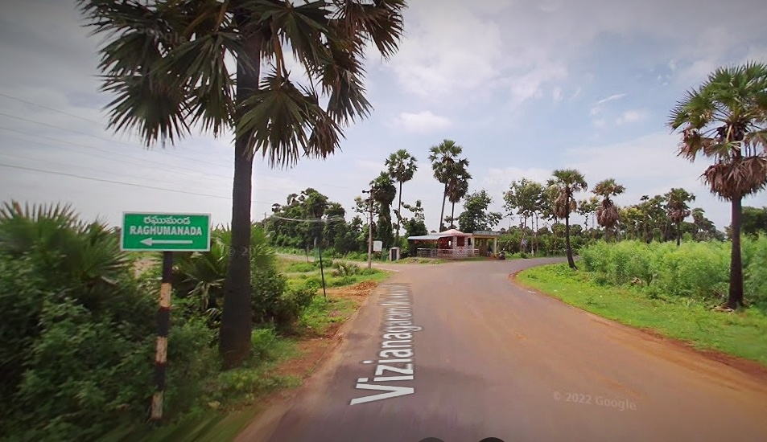
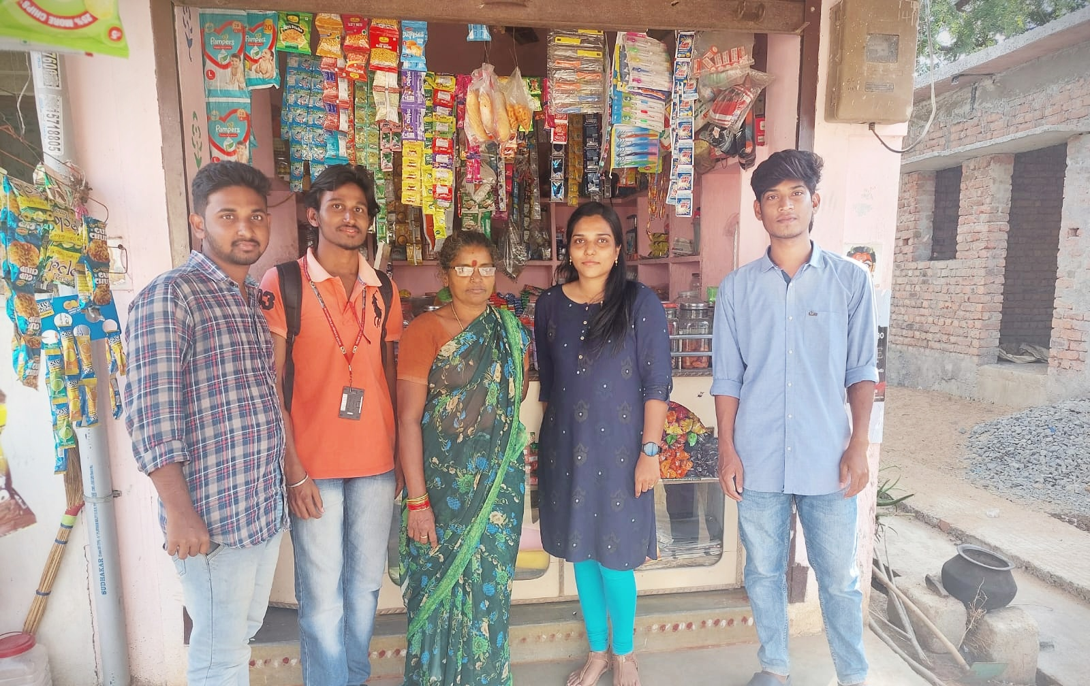
INTRODUCTION
Raghumanda village is located in Denkada mandal of Vizianagaram district in Andhra Pradesh, India.
Vizianagaram is the nearest town to this village for all major economic activities, which is approximately 8km away.
It is situated 16km away from sub-district headquarter Denkada and 8km away from district headquarter, Vizianagaram.
Farming is major occupation in this village.

Slide 3
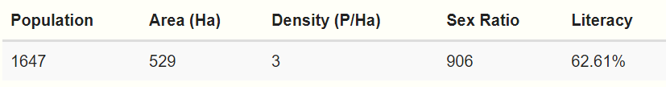
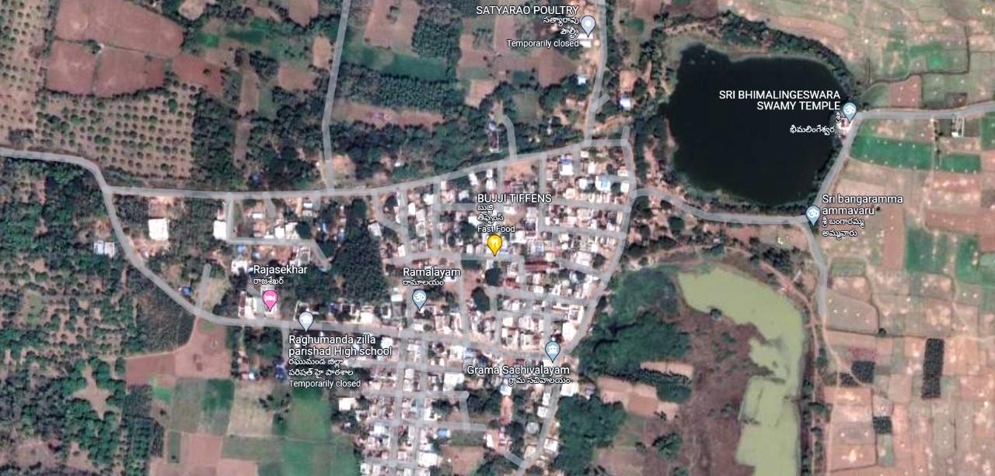
The total geographical area of this village is 529 hectares.
Raghumanda has a total population of 1,647 peoples, out of which 864 are males & 783 are females.
There are about 410 houses in this village.

Slide 4
Sl. No. | Basic Facilities | Availability (Yes/No) | Description
1. | Schools | Yes | Two Government schools & One Private school.
2. | Roads | Yes | Connected with bitumen roads & partly with kutcha road.
3. | Bank & Atm | Partial | Grameena Vikas Bank, but no ATM facility.
4. | Hospital | No | Construction of new hospital is in progress. Weekly medication camps were conducted.
5. | Anganwadi kendra | Yes | Two Anganwadi’s.
6. | Petrol Bunk | No | NA
7. | Restaurants/Hotel | No | Only Tiffin centres.
8. | Waster supply | Yes | Overhead tank water is supplied daily for 1.5 hour.
9. | Transportation Facility | Partial | Only autos are available.
10. | Police station | No | NA

Slide 5
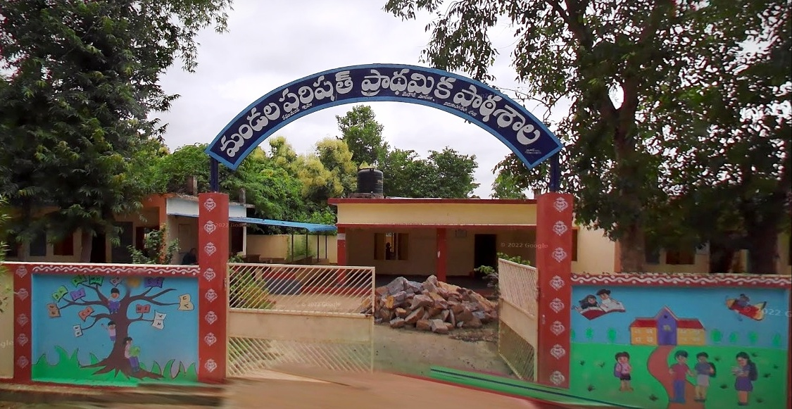
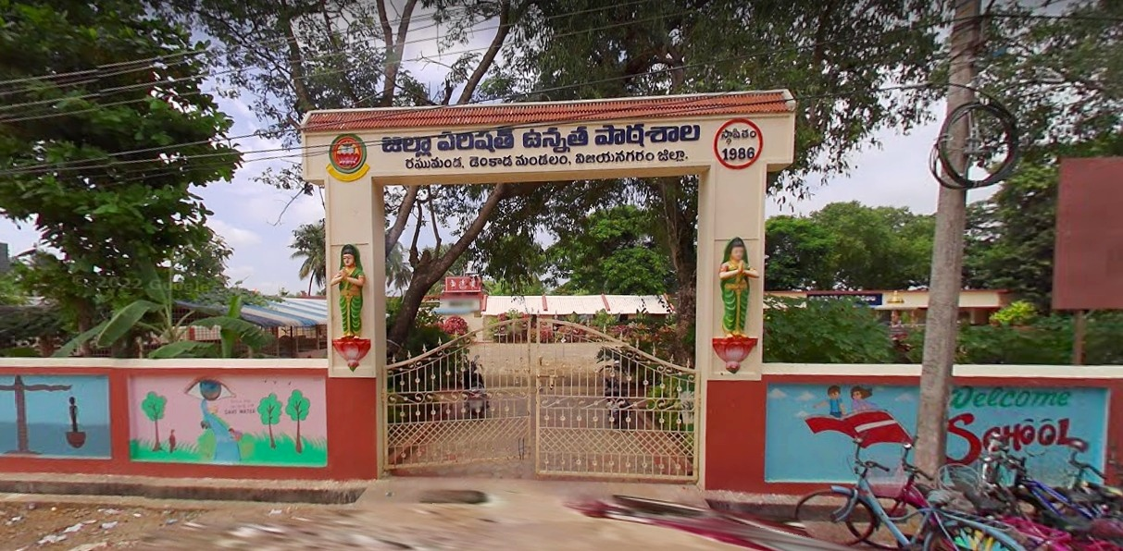
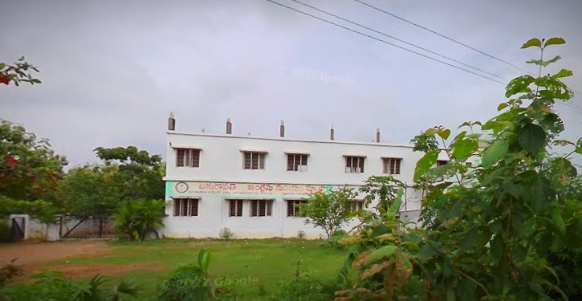
Educational Institutions :-
Government Elementary School
ZP High School
Total 921 people in this village are literate, among them 537 are male and 384 are female.
Literacy rate – 55.92%.
Males - 62.15%
Females - 49.04%
Quality of Education is good.
Amaravathi English Medium School

Slide 6
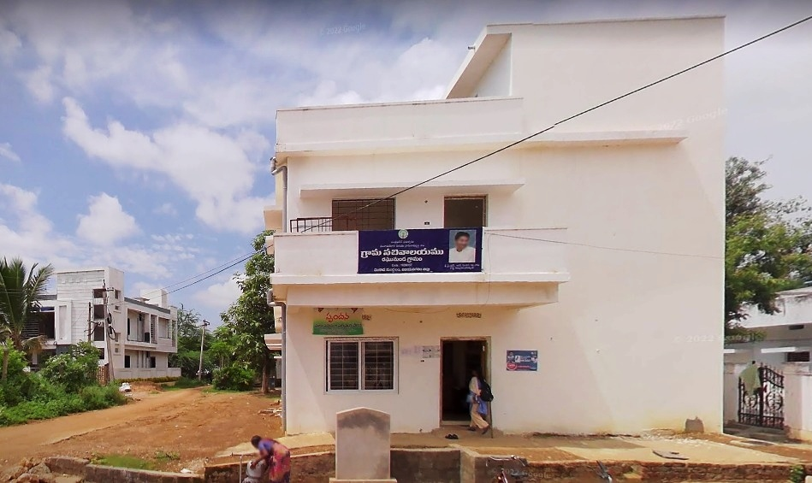


Government Buildings :-
Sachivalayam office.
VRO office.
Grameena Vikas Bank.
Anganwadi.
Benifits from Government :-
YSR Raithu Bharosa.
Arogyasri.
Ammavodi.
YSR colonies (Housing for poor).
Pensions.

Slide 7
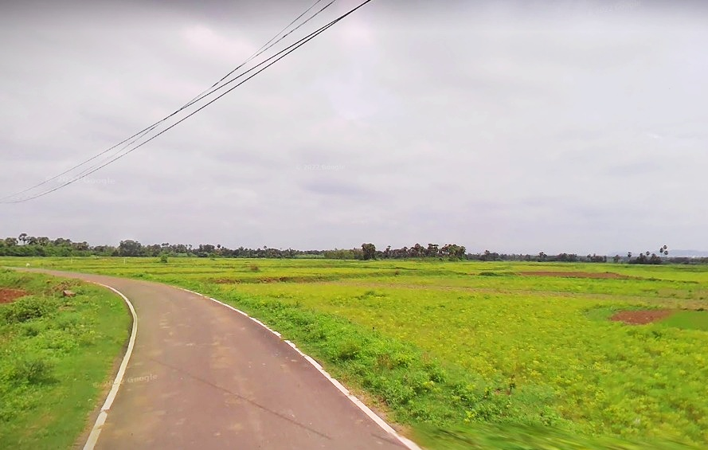
Agriculture Details :-
Type of Crop Grown : Paddy Crop (Vari).
Sources of water : Gudigundam, Pedha cheruvu and Kothagundam.
Quality of water : Suitable for cultivation.
Problems Identified :-
Open burning of domestic waste without proper disposal.
Improper maintenance of drainage system.
Insufficient water for cultivation, at times of less rainfall.
Disturbance due to mosquitoes & dogs.
Electricity & Signal problems.
Job Scarcity.

Slide 8
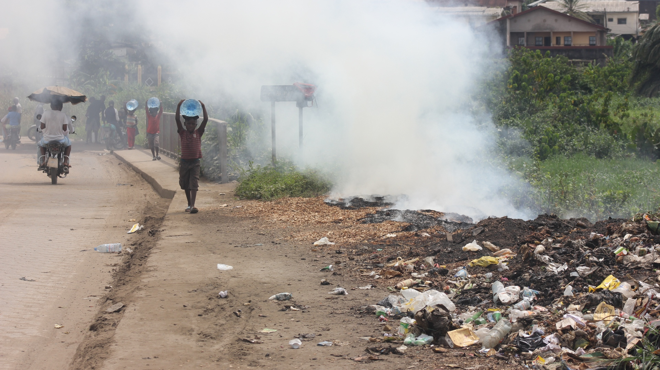
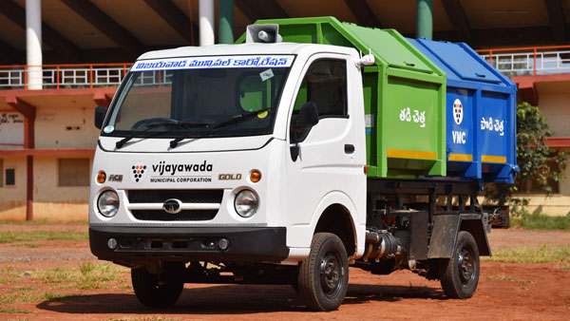
Assessment on effects of open burning of domestic waste
PROBLEM STATEMENT

Slide 9
Open burning of domestic waste :-
Open burning refers to burning garbage in barrels, open pits, outdoor furnaces, wood stoves, or fireplaces without proper disposal of waste.
Causes of open burning :-
Human negligence due to lack of awareness on effects of open burning of domestic waste.
Improperly maintained drainage system.
To avoid paying for regular waste collection service.
Effects of open burning of waste :-
Emission of smoke & harmful substances.
Severe health effects such as breathing difficulties.
Environmental effects.

Slide 10
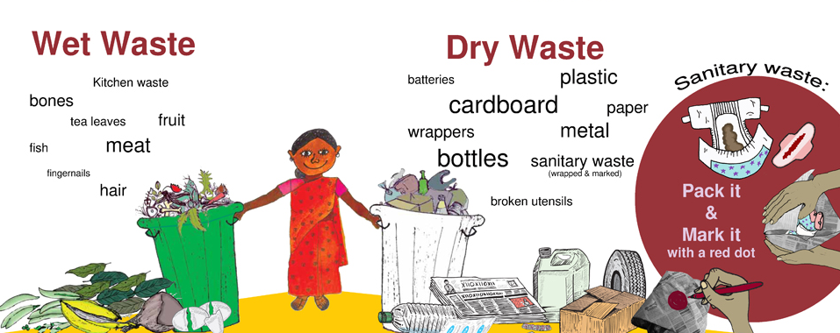
SOLUTION
Awareness on importance of segregation of waste at household level
Creating awareness on importance of segregation of domestic waste at household level for ensuring proper disposal of waste is chosen to be the best solution to tackle this problem of burning waste.

Slide 11
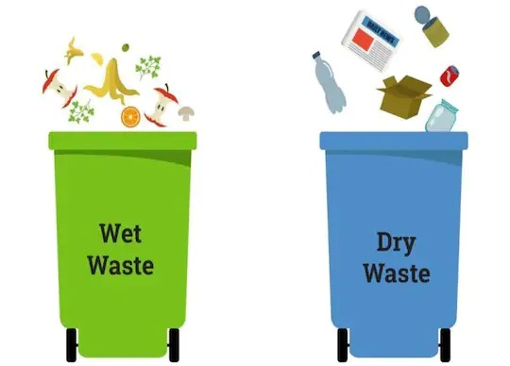
Segregation of waste :-
Segregation of waste refers to practice of separating waste into two forms i.e. into wet waste and dry waste.
This segregation is essential because it makes the task of recycling dry non-biodegradable waste easier.
It also simplifies the conversion of wet waste like leftover food, used tea leaves, etc. to compost.
Importance of segregation of waste :-
Minimizes health risks.
Makes the job easier for waste collectors.
Minimizes dumping & Promotes recycling.
Beneficial for upcoming generations.

Slide 12
Procedure to Segregate the waste :-
Label and keep two separate containers, one for wet waste and the other for dry waste (use different colours to differentiate quickly).
Keep two bags for dry waste collection, one for plastics and paper and the other for the rest of the household waste.
Dispose sanitary waste (Diapers, synthetic sanitary napkins and hygiene-related products) in a paper bag.
Keep plastic waste from the kitchen clean and dry before you drop it into the dry waste bin. Keep glass/plastic containers rinsed of food matter.
Wet waste should be sent out for composting daily. Try sending dry waste for recycling once every week.

Slide 13
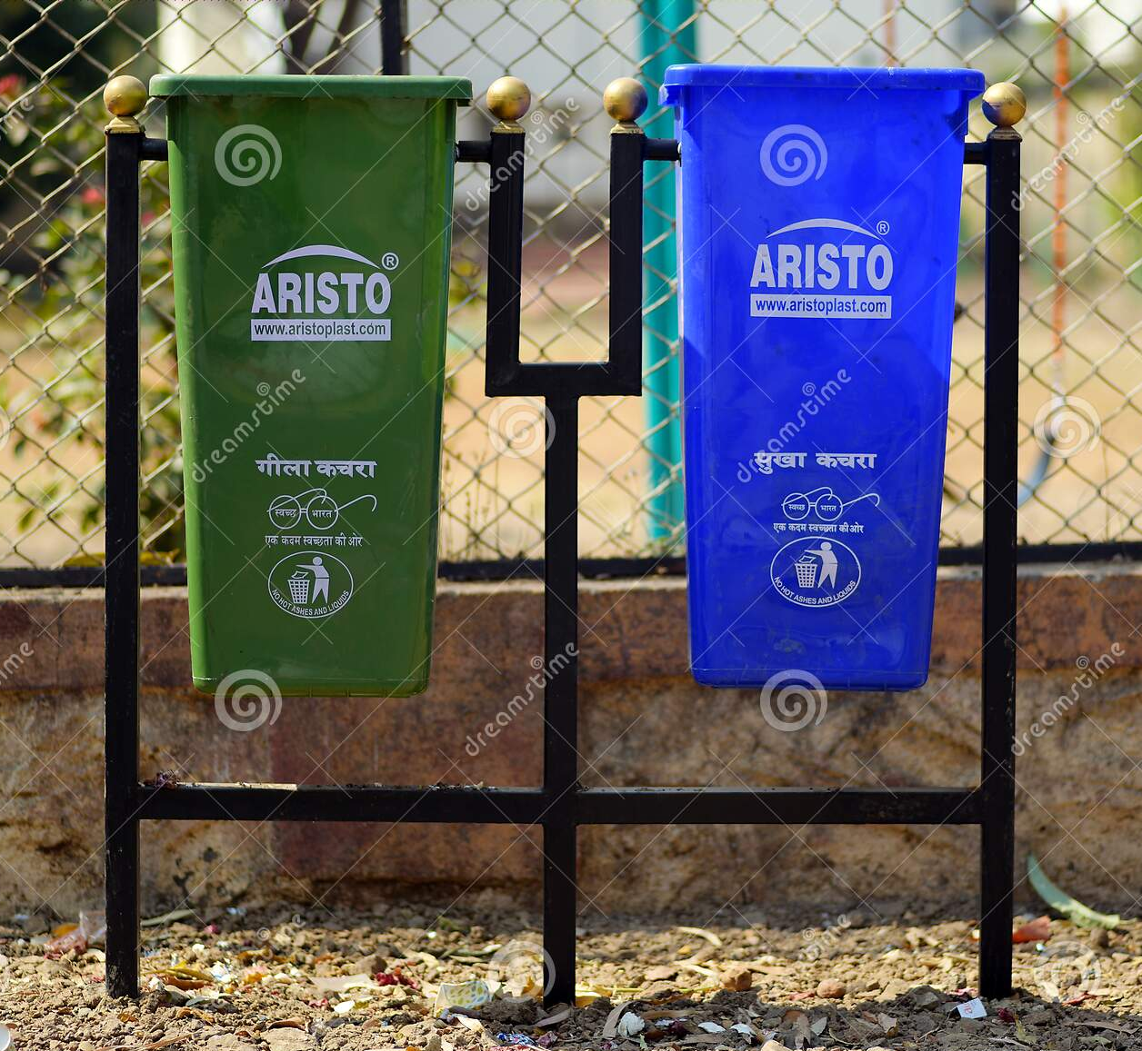
CONCLUSION
Awareness on importance of segregation of waste at household level
Hence by creating awareness on importance of segregation of domestic waste at household level helps in reducing all the problems that may arise because of open burning of domestic waste which
in turn results in efficient management
of waste .
Making people of the village aware of this makes them realize their role & responsibility towards the nature & society.
Making them segregating the waste before disposal makes the management process easier and reduce severe health problems that may occur.

Slide 14


